Slide 1
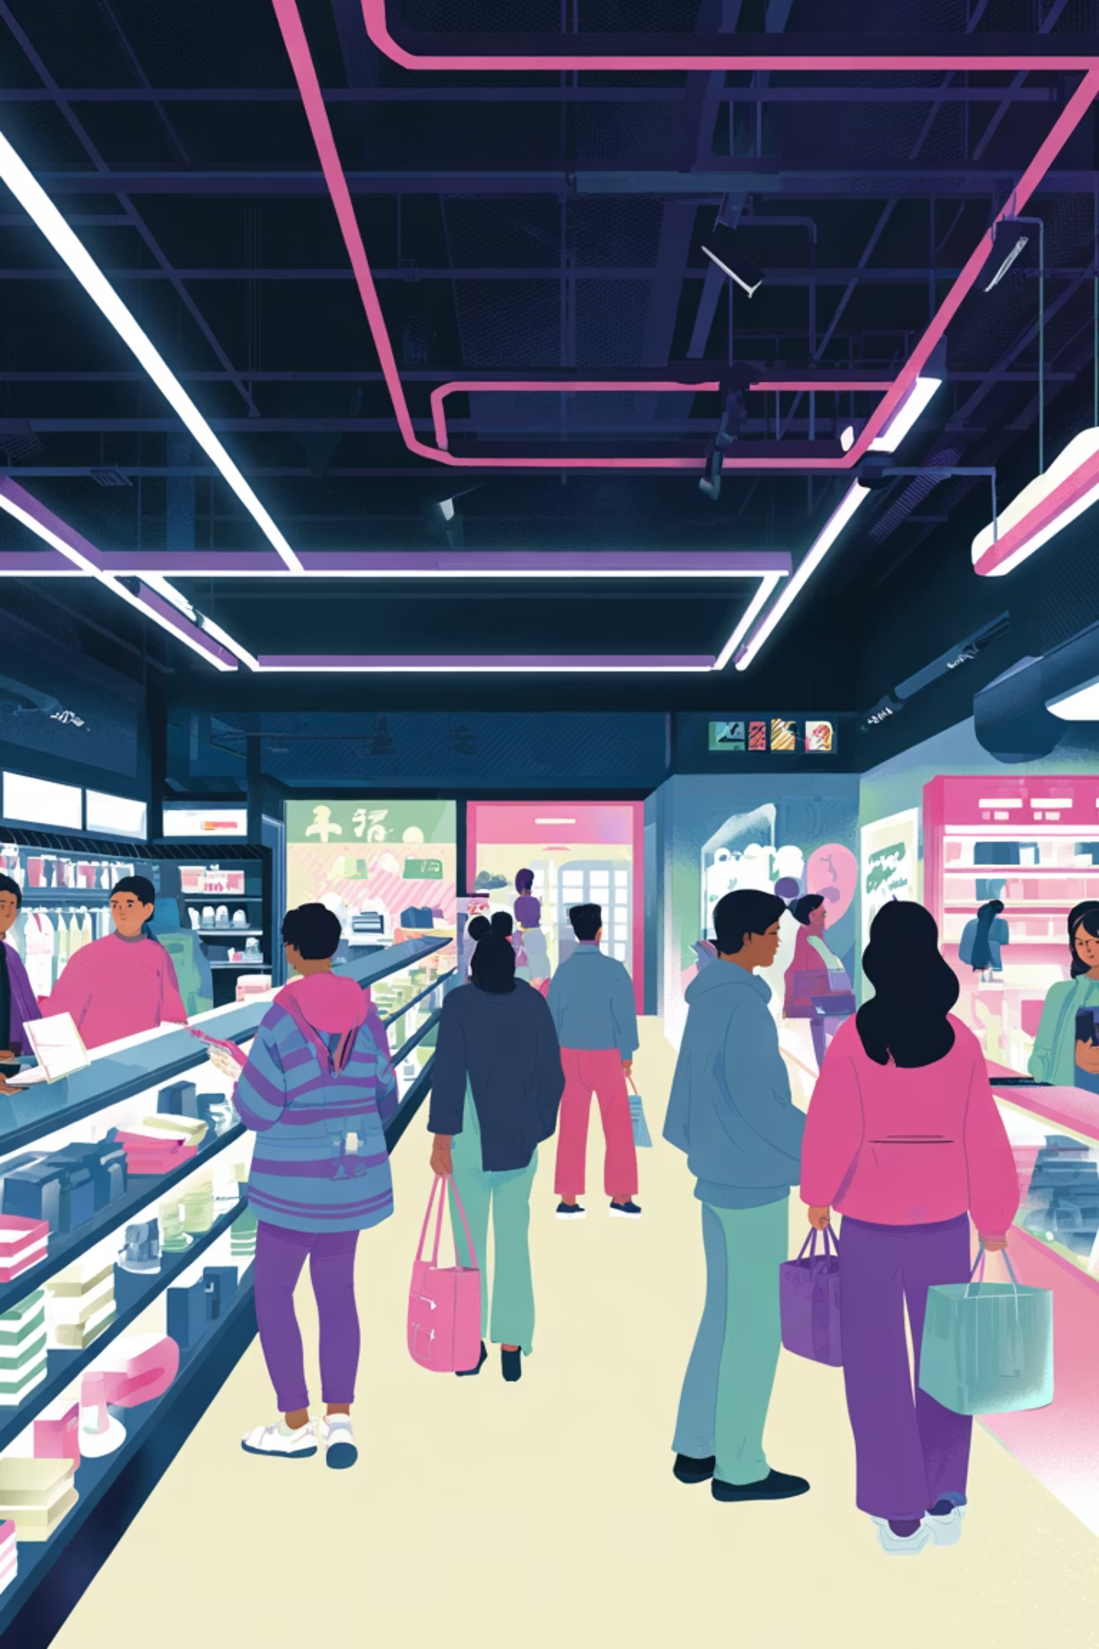
Customer Shopping
Behavior Analysis
Uncovering insights from 3,900 purchases across product categories to guide strategic business decisions through data-driven analysis.

Slide 2

Dataset Overview
3,900 Purchases
18 Data Columns
Transactions analyzed across multiple product categories and customer segments.
Demographics, purchase details, behavior metrics, and shipping information captured.
37 Missing Values
Review Rating column had minimal gaps, handled through median imputation by category.

Slide 3

Customer Demographics & Spending
Age Range
Average Purchase
Gender Split
18–70 years, average age 44 years old across customer base.
$59.76 per transaction with spending ranging from $20–$100.
Female customers: $75,191 revenue. Male customers: $157,890 revenue.

Slide 4

Revenue by Customer Segment
3116
701
83
Loyal Customers
Returning Customers
New Customers
Repeat buyers driving majority of revenue.
Small segment requiring acquisition focus.
Moderate engagement with growth potential.

Slide 5
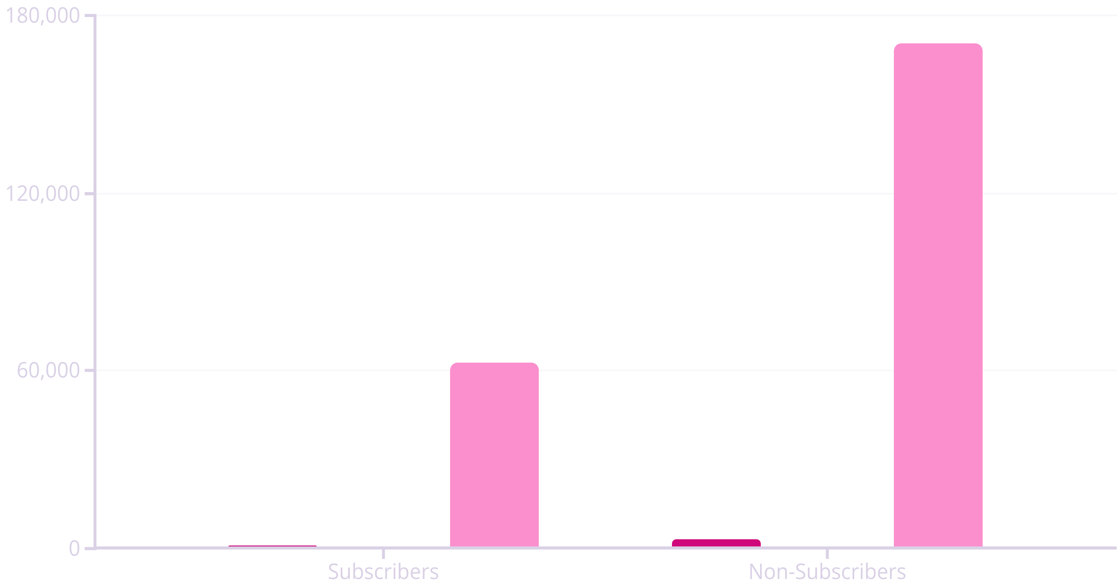
Subscription Impact Analysis
Total Customers
Avg Spend
Total Revenue
Non-subscribers represent 73% of customer base but similar average spend. Subscription growth opportunity identified.

Slide 6
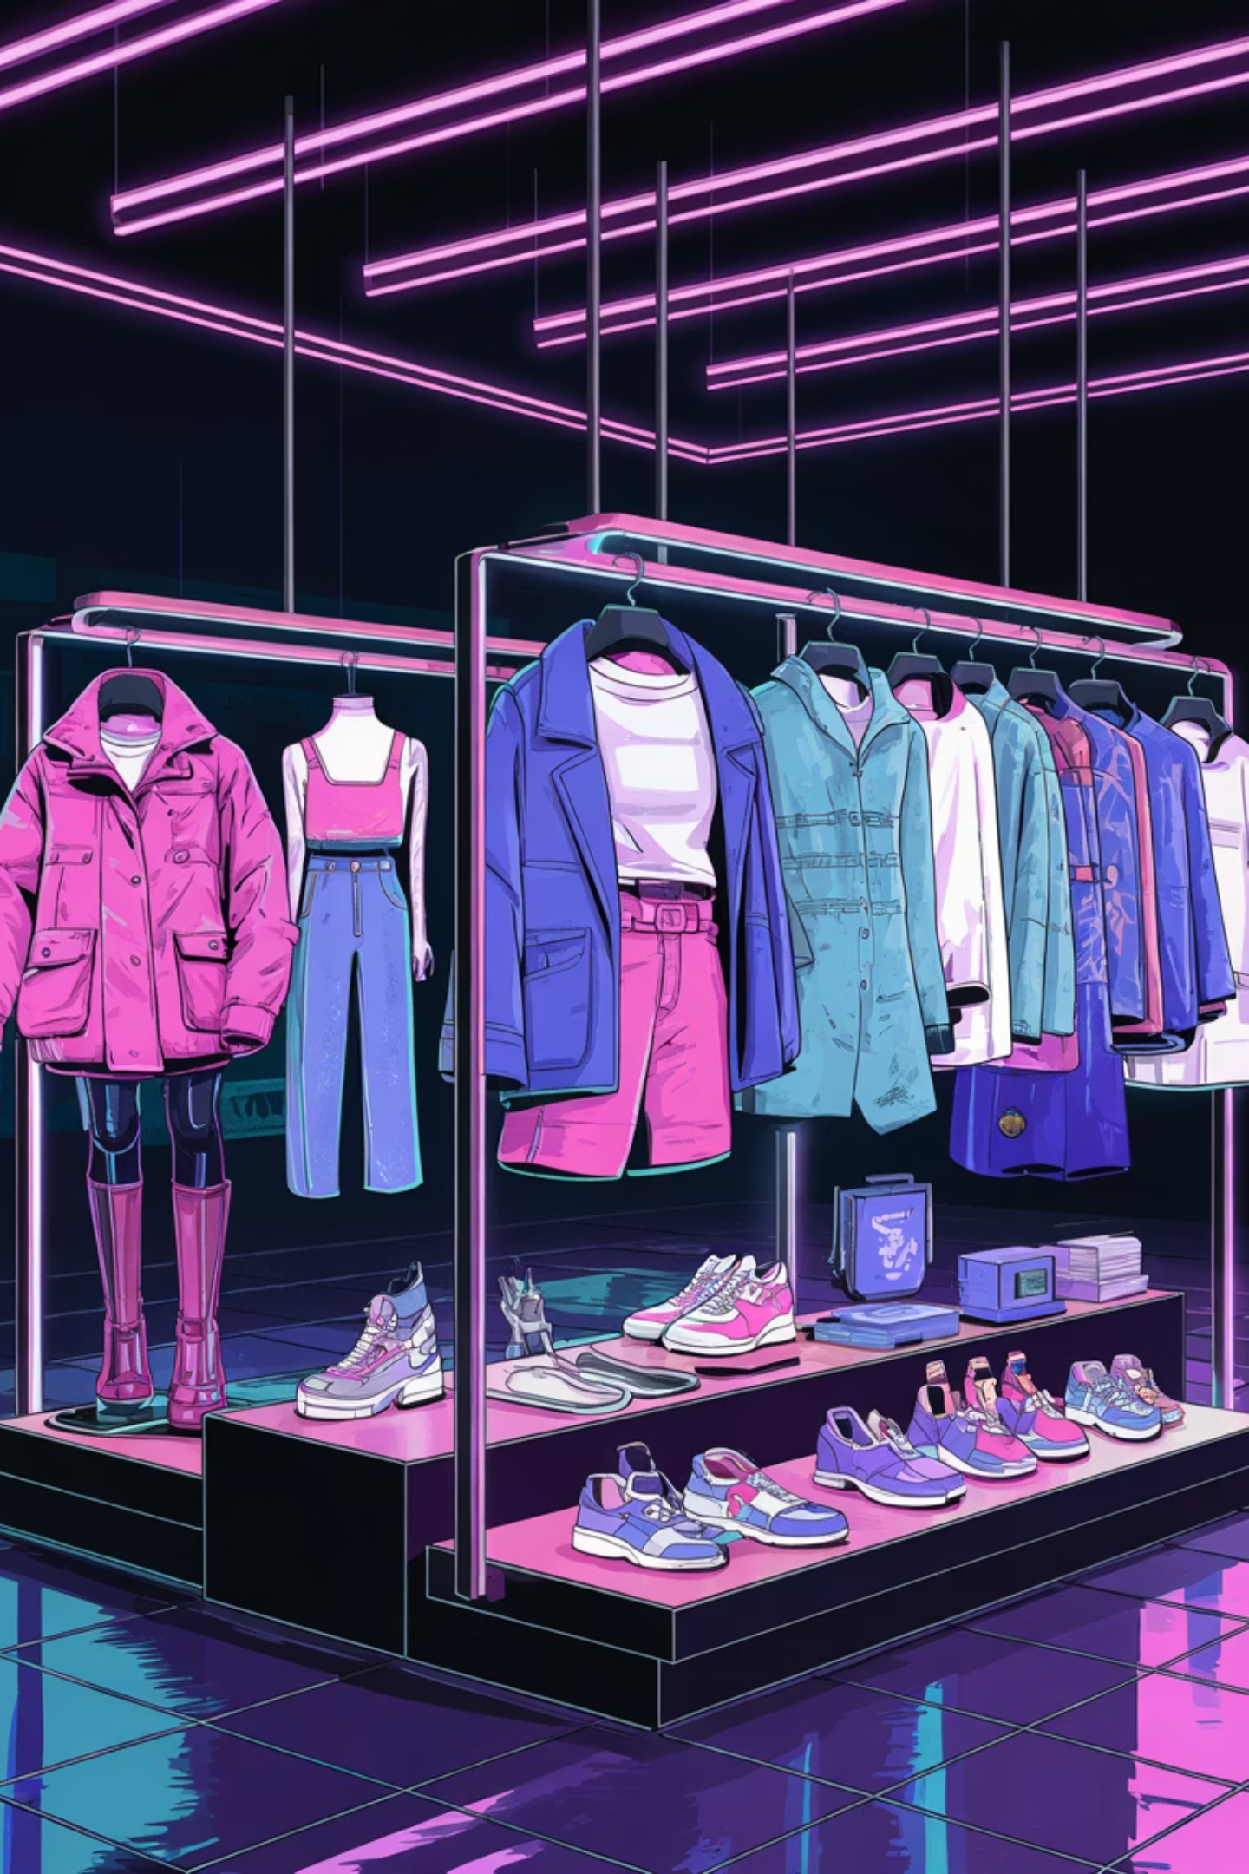
Top Products & Categories
Highest Rated
Most Purchased
Gloves (3.86), Sandals (3.84), Boots (3.82) lead customer satisfaction.
Blouse, Jewelry, and Sandals drive volume across Clothing, Accessories, and Footwear.
Discount Dependent
Hat (50%), Sneakers (49.66%), Coat (49.07%) rely heavily on promotions.

Slide 7
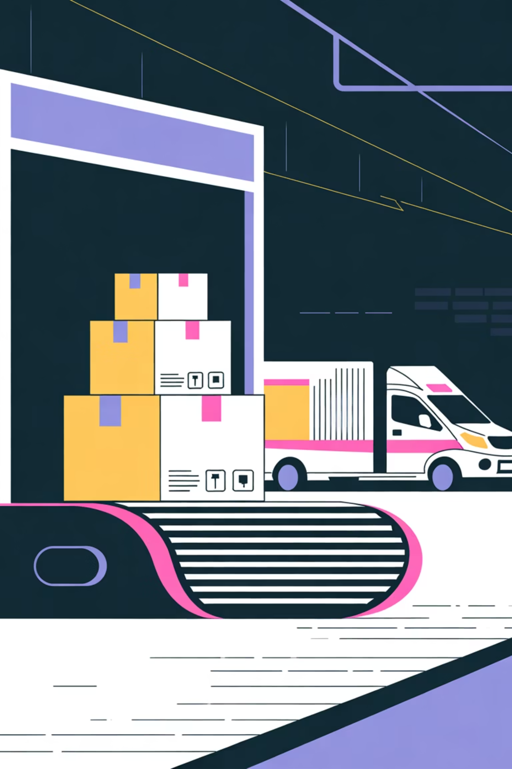
Shipping & Discount Behavior
Shipping Preference
Discount Usage
Standard: $58.46 avg purchase
839 high-spending discount users identified—customers who used discounts yet spent above average.
Express: $60.48 avg purchase
Express users spend 3.5% more per transaction.
Indicates price-conscious but quality-focused segment.

Slide 8
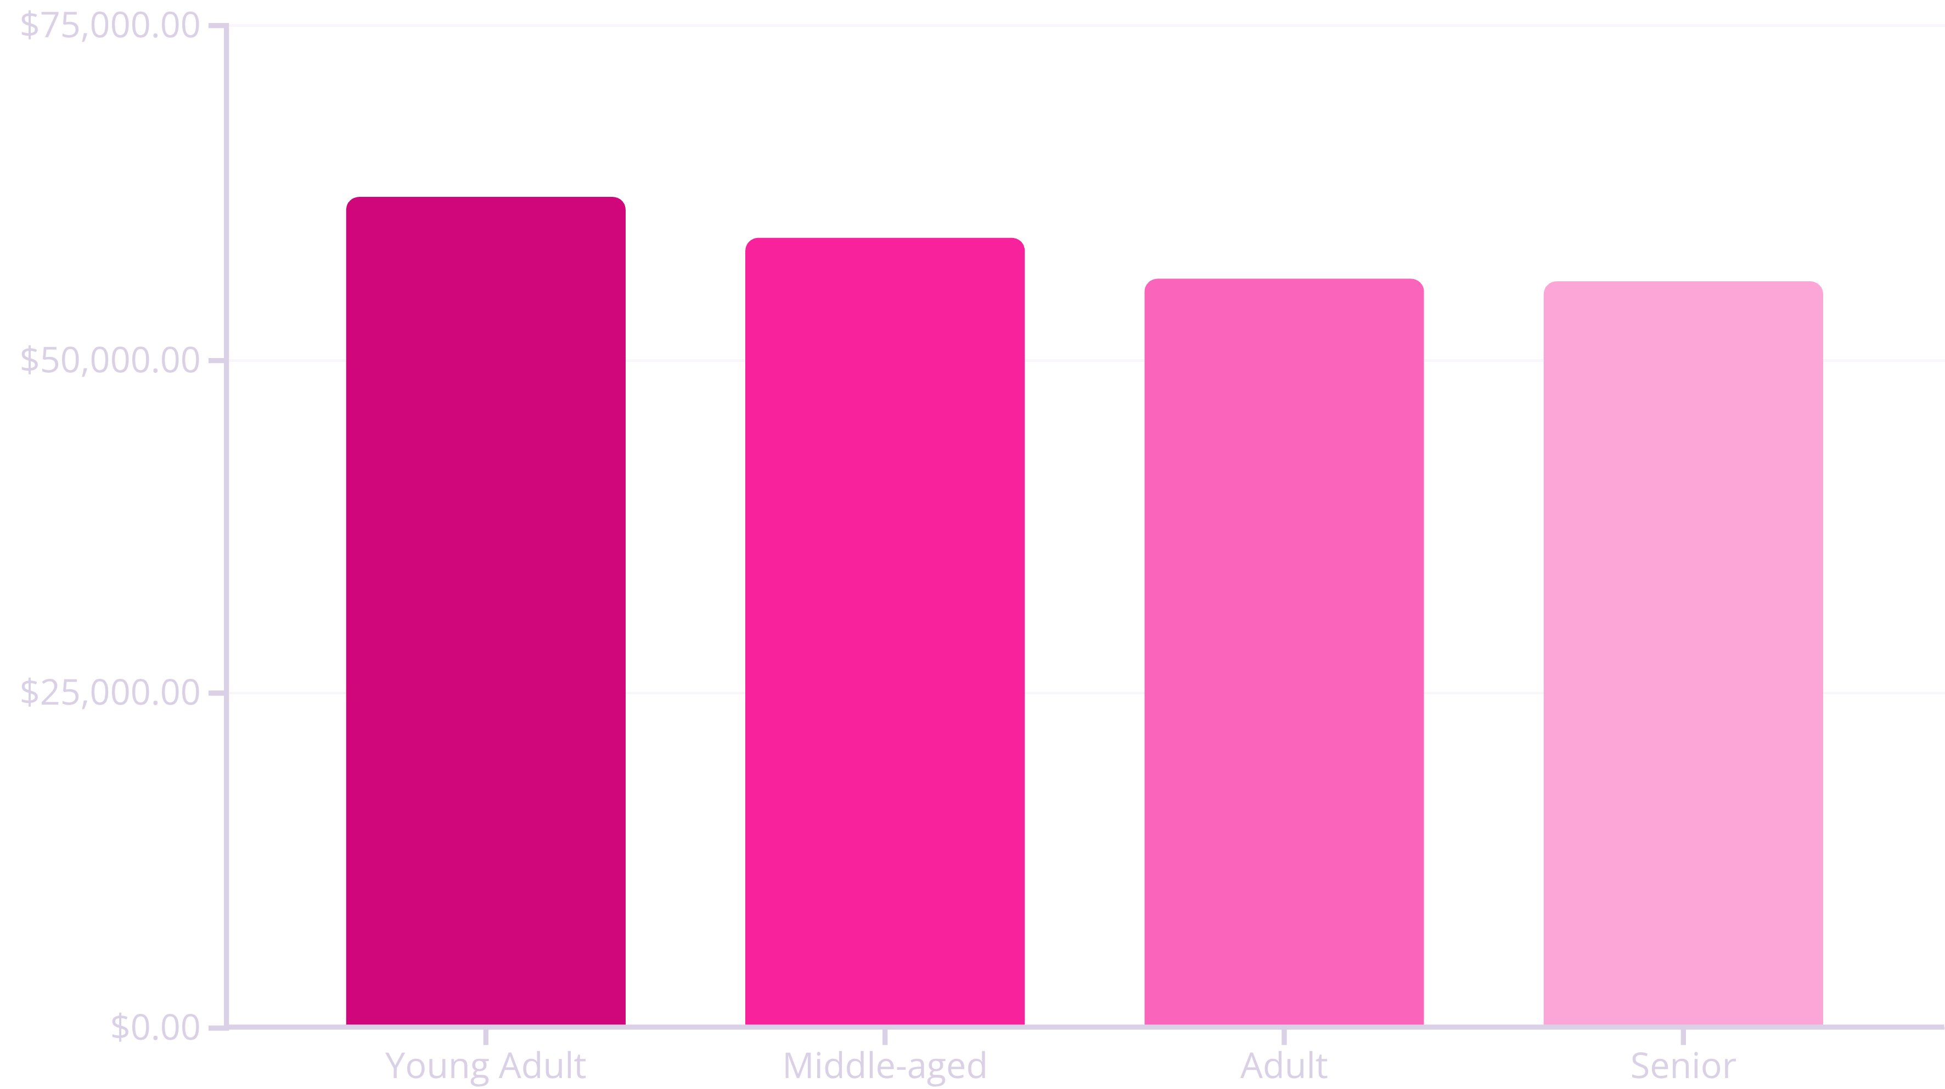
Revenue by Age Group
Young adults lead revenue generation. Balanced contribution across all age groups suggests broad market appeal.

Slide 9
Strategic Recommendations
1
Boost Subscriptions
2
Loyalty Programs
Promote exclusive benefits to convert 2,847 non-subscribers and increase recurring revenue.
Reward repeat buyers to move 701 returning customers into the 3,116-strong loyal segment.
3
Review Discount Policy
4
Targeted Marketing
Balance promotional spending with margin control, especially for Hat, Sneakers, and Coat categories.
Focus campaigns on high-revenue age groups and express-shipping users for maximum ROI.

Slide 10

Key Takeaways
Data-Driven Insights
Growth Potential
3,900 transactions analyzed across 18 dimensions reveal clear customer patterns and opportunities.
Subscription conversion and loyalty programs can unlock significant revenue from existing customer base.
Strategic Focus
Optimize product positioning, discount strategy, and targeted marketing to maximize profitability.

